Slide 1
PYTHON FOR DATA SCIENCE AND MACHINE LEARNING - Getting Started
LearnVirtual

Slide 2
Getting Started
Welcome
Introduction of Tutors
Brief of Program
Installation of required software packages
Getting Familiar with Jupyter Notebook and how to Navigate

Slide 3
Introduction of Tutors
Aminah Mardiyyah Rufai
Social media handles:
- Twitter - @diyyah92
- LinkedIn - https://www.linkedin.com/in/aminah-mardiyyah-rufa-i/
Fatimah Tasallah Rufai
Social media handles :
- Twitter - @hijabiicoder
- LinkedIn - https://www.linkedin.com/in/fatimah-rufai-16b10418a/
Adeola Lawal
Social Media handles:
- Twitter - @azlawal_lawal
- LinkedIn - https://www.linkedin.com/in/adeola-lawal/

Slide 4
Introduction of Tutors
Arimoro Olayinka
Social media handles:
- Twitter - @a_predicare
- LinkedIn - https://www.linkedin.com/in/olayinka-arimoro-9279a1179/
Akintoye Stephen
Social media handles :
- Twitter - @Pee_Still
- LinkedIn -https://www.linkedin.com/in/akintoye-stephen-201a09a8/
Olah Femi Johnson
Social Media handles:
- Twitter - @olahfemi
- LinkedIn -https://www.linkedin.com/in/olahfemi/

Slide 5
Brief of Program
Introduction to Python
Getting Started with DataScience (Statistics and SQL)
Introduction to Machine Learning (Modelling and Evaluation Metrics)
REQUIRED SOFWARE PACKAGE - “ Anaconda software distribution- Jupyter Notebook and MySQL”
Basic Python Libraries for Data Science and Machine Learning
- PANDAS(Panel Data(S)) - for data preprocessing.
- NUMPY(Numerical Python) - for linear algebra
- MATPLOTLIB - for data visualization
- SEABORN - also for visualization
- SCIKITLEARN(SKLearn) - for working with classical ML algortihms

Slide 6
INSTALLING ANACONDA
visit the website : “ https://www.anaconda.com/distribution/ ”
Click on download :
Choose your operating system - Windows, mac, Linux
Download(64bit or 32bit)
Go to download folder:
Follow the prompt by the installer.
Launch Anaconda Navigator from your Start Menu
or alternatively Launch Juputer Notebook from the Start Menu (Best)
Jupyter Notebook works on your browser

Slide 7
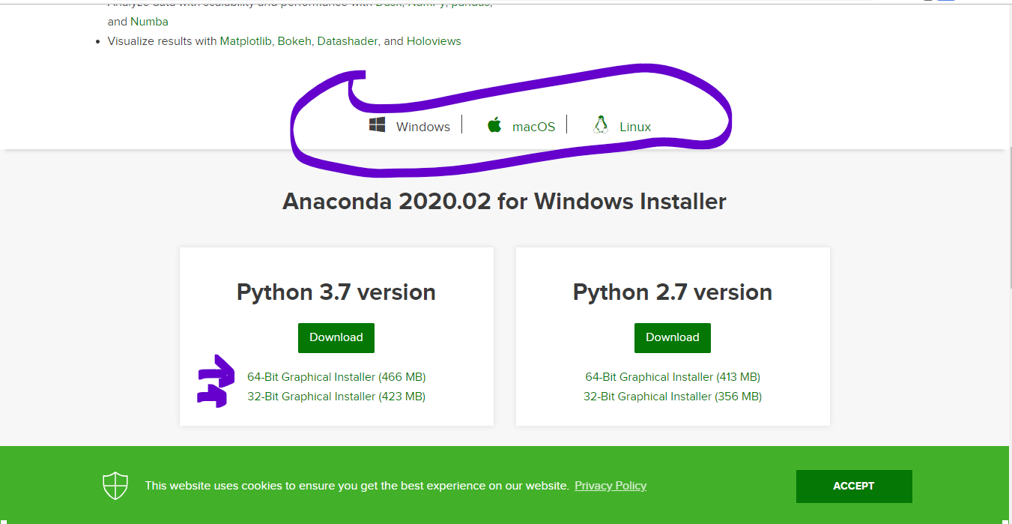
INSTALLATION PROCESS
1. Visit the website. Click on your operating system type. Choose accordingly(34bit or 64bit). View your system type on the 'system properties' on your computer.

Slide 8
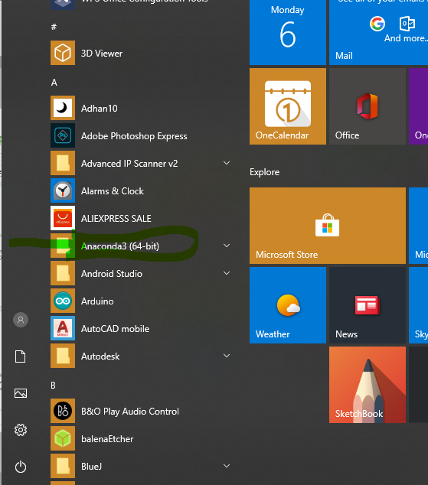
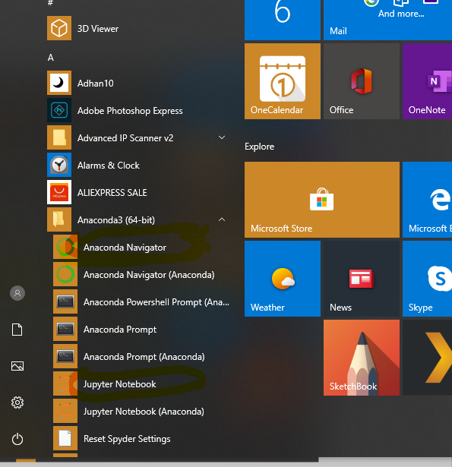
INSTALLATION PROCESS
Follow the prompt of the installer. Click on finish when it's done. Launch the Anaconda Navigator Dashboard from the Start menu

Slide 9
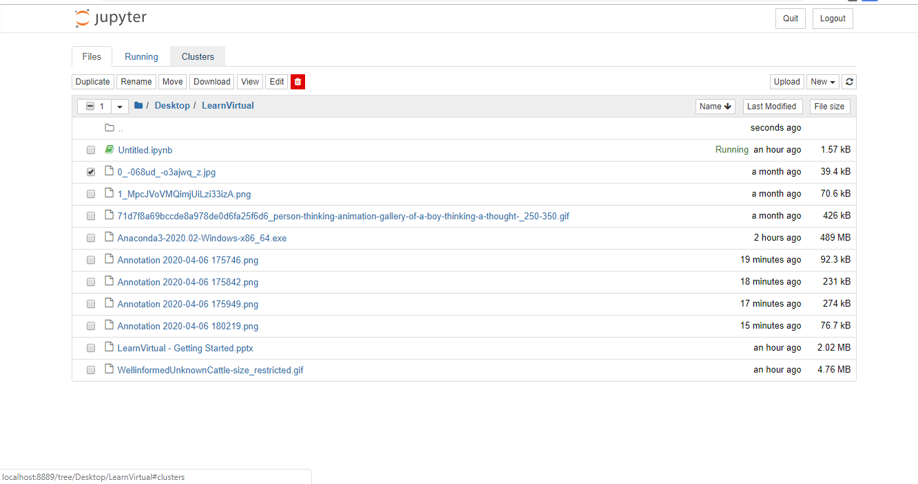
INSTALLATION PROCESS
Click on Jupyter Notebook(Default Editor for this course). Jupyter Launches on your system's default browser

Slide 10
GETTING FAMILIAR WITH JUPYTER NOTEBOOK INTERFACE
The jupyter Dashboard is just like the computer file explorer, where you can view files in folders or sub-folders and rename or navigate through.
You can rename files on the jupyter notebook by clicking on them.
Upload - for uploading files directly from your computer
the ' New' tab is used for starting a new 'Notebook' in the format .ipynb (Interactive Python Notebook)
To start a new notebook, click on new and click on python 3.

Slide 11
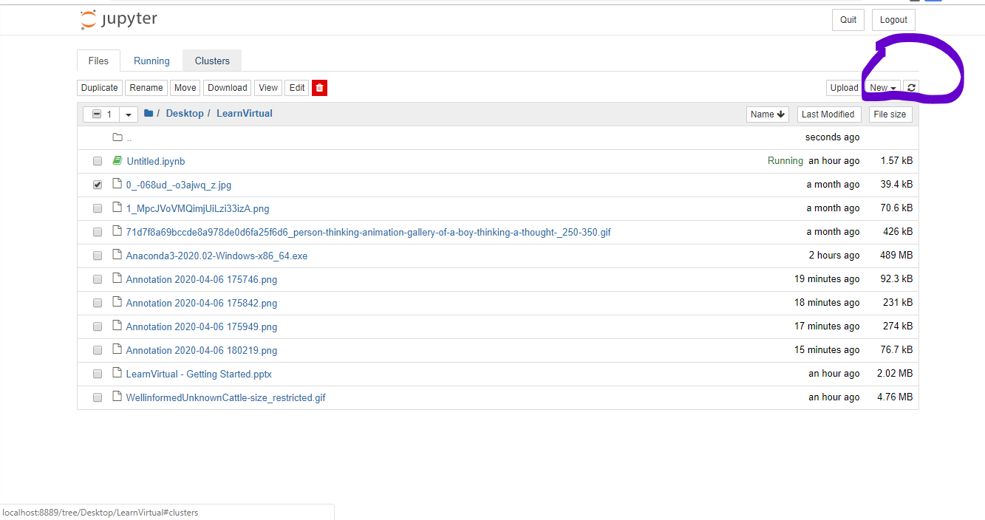
GETTING FAMILIAR WITH JUPYTER NOTEBOOK INTERFACE

Slide 12
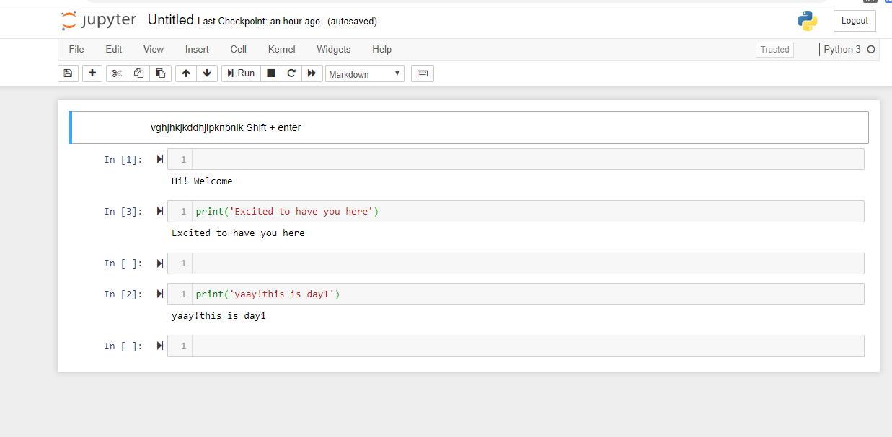
GETTING FAMILIAR WITH JUPYTER NOTEBOOK INTERFACE
Jupyter Notebook is the interactive editor where codes are run in cells. The cells are used for input. Each cell can be run independently. Cells are numbered according to how they run. use Shift + Enter to run a cell.
You can also switch between cells using the arrow keys on your keyboard.
You can also switch between codes and plain text(Markdown) using the ' Y' key- for code and 'M' key- for markdown
Insert new cells using the plus ' +' sign, cut cells using the scissors sign on the jupyter notebook

Slide 13


